Slide 1
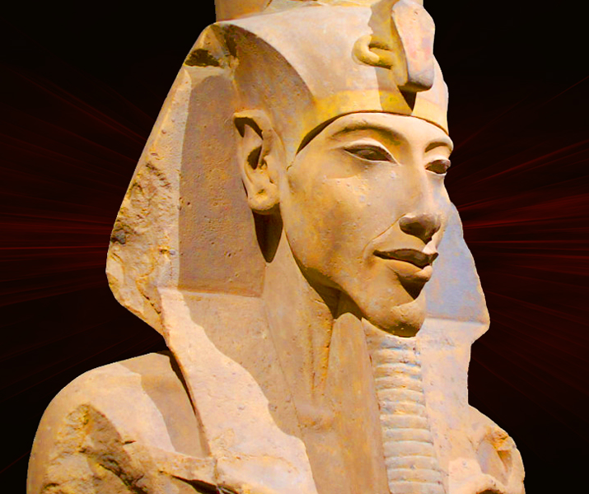
Immediate Changes
GOAL/S: Identify the immediate Changes and the Pylon Gateway at Karnak
Week 10, Lesson 3

Slide 2
Today’s Lesson
The immediate architectural and religious changes during the early years of Akhenaten's reign, focusing on the construction of the pylon gateway at Karnak.

Slide 3
Key Terms
Pylon Gateway
Karnak
Temple of Amun
Inscription

Slide 4
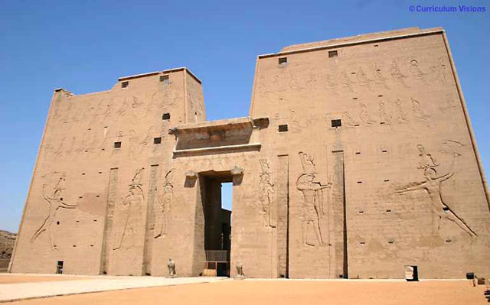
Pylon Gateway
KEY TERM
A monumental entrance to an Egyptian temple complex, typically consisting of two large towers flanking a central doorway.
WRITE THIS DOWN
Notes:
IV = 4

Slide 5
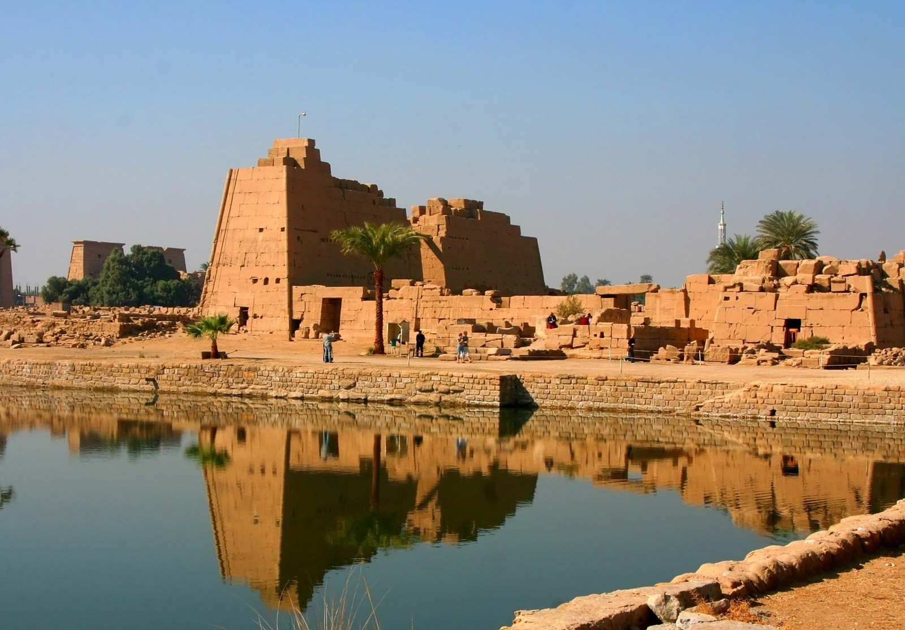
Karnak
KEY TERM
A vast temple complex located near the modern city of Luxor in Egypt, dedicated primarily to the god Amun
WRITE THIS DOWN
Notes:
IV = 4

Slide 6
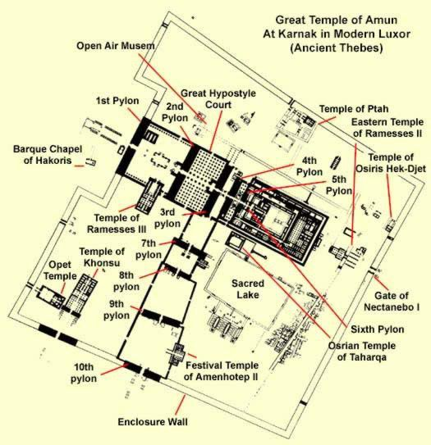
Temple of Amun
KEY TERM
The main temple within the Karnak complex, dedicated to the god Amun.
WRITE THIS DOWN
Notes:
IV = 4

Slide 7
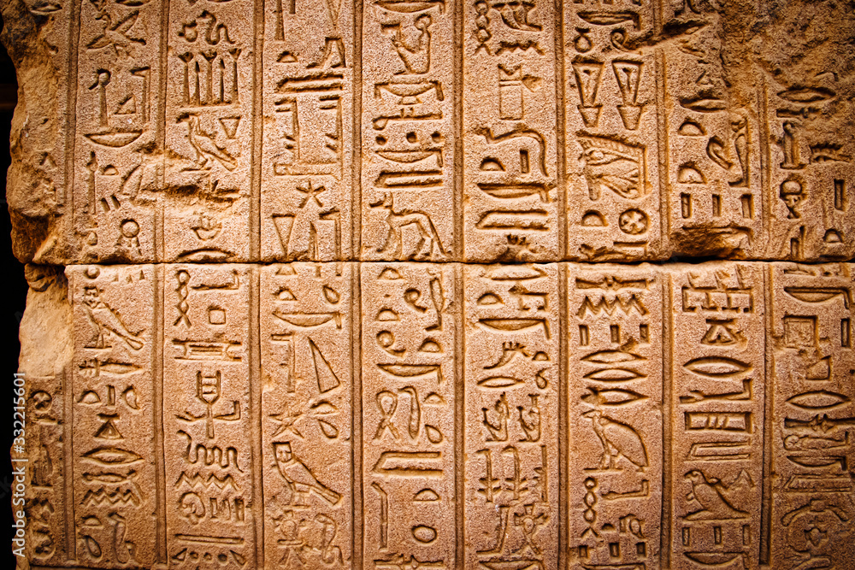
Inscription
KEY TERM
Writing or carving on a surface, such as stone, that provides information or commemorates an event.
WRITE THIS DOWN
Notes:
IV = 4

Slide 8
Architectural Changes
Akhenaten's reign was characterized by significant construction projects
Projects aimed at promoting his religious reforms and solidifying his authority.
These projects included:
construction of temples and monuments dedicated to the Aten, the new solar deity introduced by Akhenaten.

Slide 9
Pylon Gateway
The pylon gateway at Karnak was one of the earliest and most significant architectural projects undertaken during Akhenaten's reign.
Located at the Temple of Karnak, one of the most important religious sites in ancient Egypt, the pylon gateway served as the entrance to the temple complex.
The gateway featured images and inscriptions dedicated to the Aten, prominently displaying the new religious focus of Akhenaten's reign.
The construction of the pylon gateway symbolised Akhenaten's personal devotion to the Aten and his commitment to promoting the worship of the new god throughout Egypt.

Slide 10
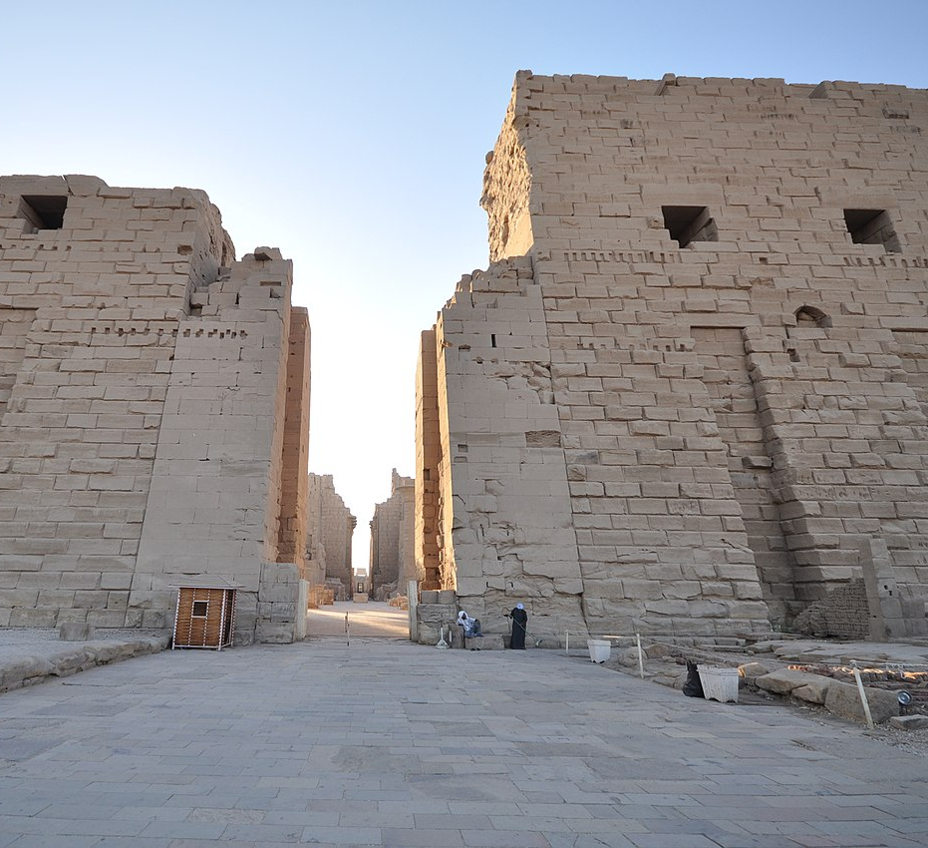
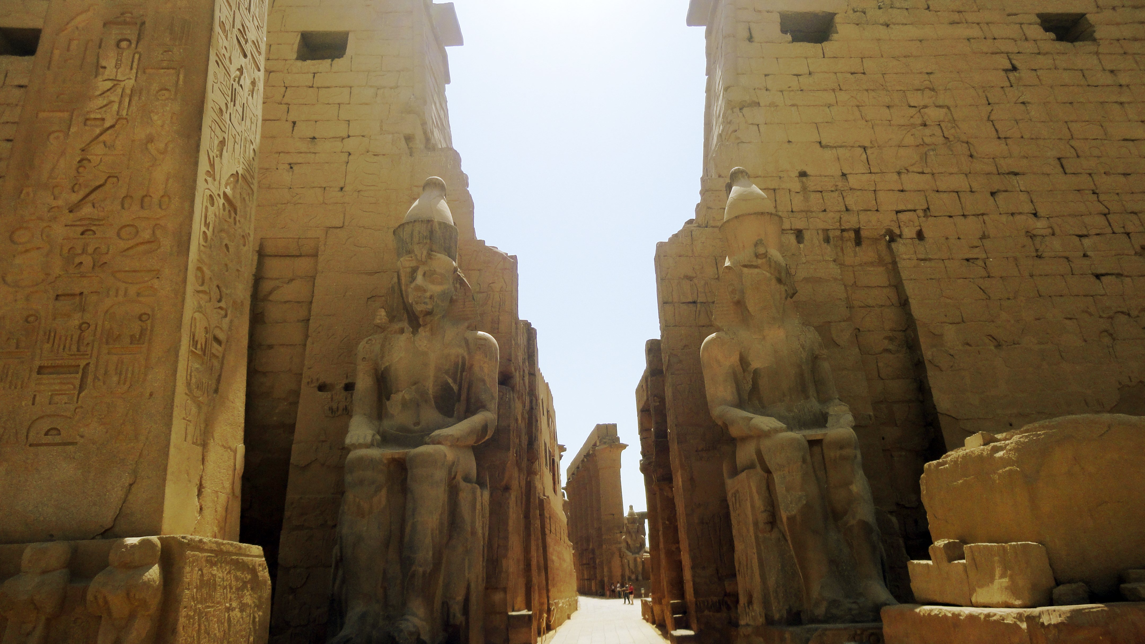
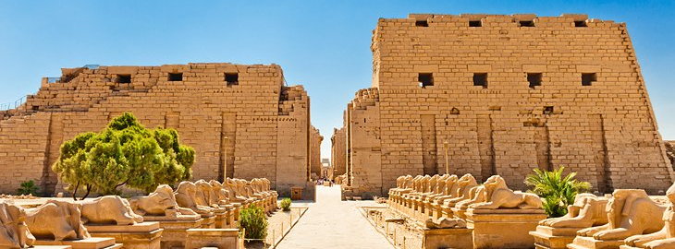

Slide 11
Religious and Political Impact
The construction of new temples and monuments dedicated to the Aten, including the pylon gateway at Karnak, played a crucial role in supporting Akhenaten's religious reforms.
These new religious structures served as focal points for the worship of the Aten
Helped to spread the ideology of monotheism throughout Egypt.
The emphasis on the worship of the Aten and the reduction of the influence of traditional gods, such as Amun, also had significant political implications.
By centralising religious authority around the Aten and diminishing the power of the priesthood of Amun, Akhenaten was able to consolidate his own authority as both a religious and political leader.

Slide 12
ACTIVITY – TEEL Paragraph
In your essay, you will be required to write 3 TEEL paragraphs based on an essay question.
Your TEEL paragraphs must link to the THESIS statement.
In this activity, we will develop our own thesis statement, plan our paragraph, and write a practice TEEL structured paragraph.

Slide 13
I do, We do, You do
What does this mean?

Slide 14
Essay Planning – Thesis Statement
I DO
Evaluate the impacts of Akhenaten’s immediate changes at Karnak.
Thesis Statement:

Slide 15
Essay Planning – Body Paragraphs
I DO
Evaluate the impacts of Akhenaten’s immediate changes at Karnak.
Thesis Statement:
1.
2.
3.

Slide 16
Essay Planning – Body Paragraph 1
I DO
Evaluate the impacts of Akhenaten’s immediate changes at Karnak.
Thesis Statement:
BODY PARAGRAPH ONE PLANNING:

Slide 17
Essay Planning – Writing a TEEL paragraph
I DO
Evaluate the impacts of Akhenaten’s immediate changes at Karnak.
Thesis Statement:
BODY PARAGRAPH 1

Slide 18
YOUR TURN!
Write a teel paragraph based on the question

